Slide 1
WATER CONSERVATION PORTAL
AquaTrack — Gamified Water Conservation Monitoring Portal
TEAM 6
Salini Saju
Sam Paul Peter
Samayi A S
Sampreet
Santo Joseph
Sara Mary
SDG 6 • Clean Water & Sanitation
WATER CONSERVATION PORTAL • TEAM 6 1/12

Slide 2
1. Problem Statement
Why a water-conservation monitoring portal is needed
• Water wastage can occur through leaks, overflowing fixtures, damaged plumbing, and inefficient irrigation.
• Users may not know how much water they consume because feedback is often delayed or unavailable.
• Manual reporting of wastage can make it difficult to communicate an issue and track corrective action.
• Without engagement or incentives, users may not consistently adopt water-saving habits.
Core Need
A simple digital system that connects monitoring,
reporting, user participation and conservation
actions in one place.
Monitor
Detect
Report
Act
WATER CONSERVATION PORTAL • TEAM 6 2/12

Slide 3
2. Sustainability Analysis
Environmental, social and economic dimensions
Environmental Sustainability
Social Sustainability
Economic / Operational
• Encourages reduction of unnecessary
water consumption
• Supports faster reporting of leaks
and wastage
• Can complement water-efficient
irrigation and greywater reuse
• Contributes to responsible use of a
limited resource
• Gives students and residents a
direct role in conservation
• Uses challenges, badges and
leaderboards to encourage participation
• Makes wastage visible and easier
to report
• Builds awareness through feedback
and community comparison
• Helps identify avoidable consumption
and wastage
• Supports data-based decisions by facility
teams
• Creates a record of reported issues and
corrective action
• Digital monitoring can reduce
dependence on manual tracking
WATER CONSERVATION PORTAL • TEAM 6 3/12

Slide 4
3. Individual Proposed Solutions — I
Members 1 and 2
Member 1 — Smart Monitoring
Member 2 — Leak Detection
Portal focuses on tracking water consumption through
dashboards and graphs.
Key contribution:
• Meter-reading entries
• Consumption trends
• Usage feedback
• Dashboard-based monitoring
Portal focuses on identifying abnormal consumption and
possible leaks.
Key contribution:
• Detect unusual usage patterns
• Highlight possible leaks
• Support early intervention
• Connect detection with reporting
WATER CONSERVATION PORTAL • TEAM 6 4/12

Slide 5
3. Individual Proposed Solutions — II
Members 3 and 4
Member 3 — Gamification
Member 4 — Wastage Reporting
Portal motivates users through points, badges, challenges
and leaderboards.
Key contribution:
• XP for conservation actions
• Badges and streaks
• Community leaderboard
• Missions and challenges
Portal allows users to report water wastage and lets
authorities track corrective action.
Key contribution:
• Location and issue details
• Severity level
• Report status
• Resolution tracking
WATER CONSERVATION PORTAL • TEAM 6 5/12

Slide 6
3. Individual Proposed Solutions — III
Members 5 and 6
Member 5 — Predictive Analytics
Member 6 — Automated Greywater Recycling &
Soil-Moisture Irrigation Controller
Portal analyzes historical consumption data and predicts
future water demand / wastage.
Key contribution:
• Historical usage analysis
• Demand forecasting
• Identification of unusual trends
• Data-supported planning
Combines automated greywater reuse with soil-moisture-based
irrigation control.
Key contribution:
• Reuse suitable greywater for irrigation
• Use soil-moisture information to control irrigation
• Reduce unnecessary freshwater use
Note: the supplied proposal provides the solution title;
implementation details were not provided.
WATER CONSERVATION PORTAL • TEAM 6 6/12

Slide 7
4. Selection of the Final Solution
Why the team selected the AquaTrack portal as the final web-based solution
Coverage
Usability
Brings monitoring, reporting and user engagement into one portal.
Provides simple dashboards and clear actions for users.
Sustainability
Demonstrability
Directly supports water-use awareness and conservation behaviour.
Can be demonstrated through working web pages and interactive
sections.
FINAL WEB SOLUTION: AQUATRACK — GAMIFIED WATER CONSERVATION MONITORING PORTAL
WATER CONSERVATION PORTAL • TEAM 6 7/12

Slide 8
5. Final Solution — AquaTrack
Main functions implemented in the website
Overview
Dashboard & Meter
SDG 6-focused landing page with water-conservation actions.
Log readings and view consumption indicators and trends.
Wastage / Leak Reporting
Gamification
Submit issues with location, type, severity and status.
XP, streaks, missions, badges and leaderboard encourage participation.
The website connects the user-facing conservation actions into one digital workflow.
WATER CONSERVATION PORTAL • TEAM 6 8/12

Slide 9
6. Website Demonstration
Suggested 5–7 minute live demonstration sequence
1
Open the AquaTrack website
Show the Overview / SDG 6 landing page.
2
Open Dashboard
Enter or display a meter reading and show the consumption indicators.
3
Open Wastage Reporting
Create/show a report and demonstrate its status tracking.
4
Open Leaderboard
Show XP, streaks, missions and community ranking.
5
Explain the workflow
Connect monitoring → detection/reporting → engagement → conservation action.
WATER CONSERVATION PORTAL • TEAM 6 9/12

Slide 10
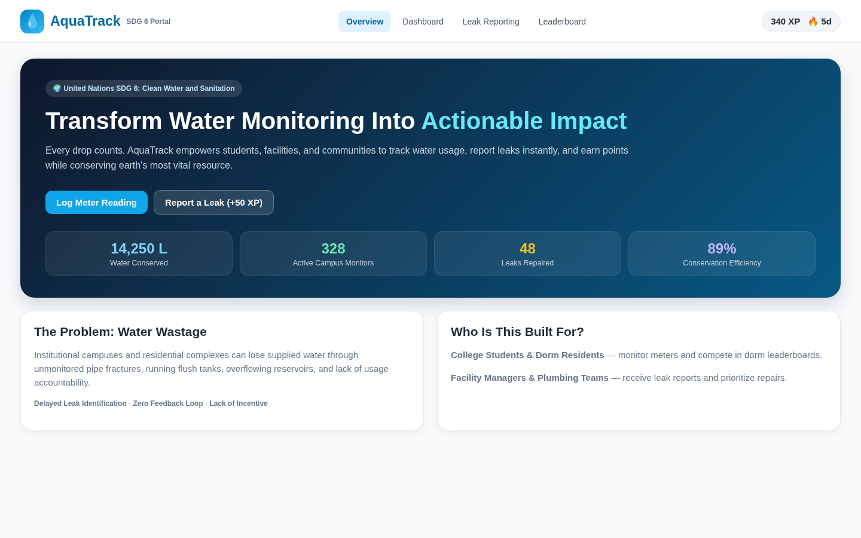
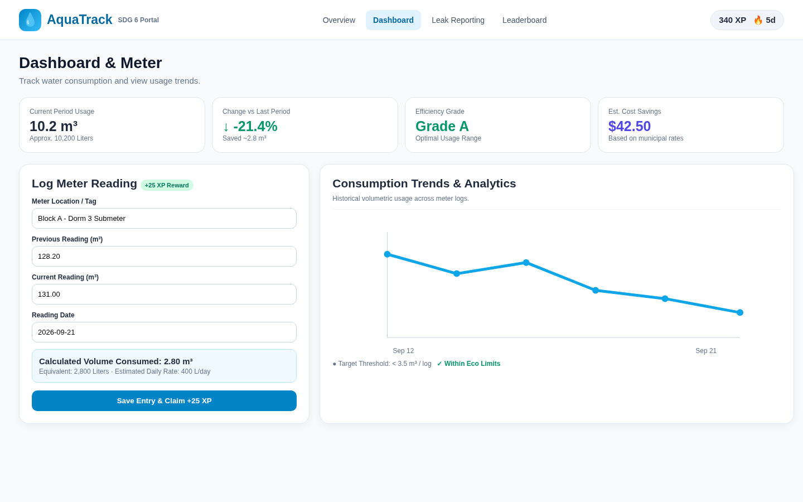
7. Website Screenshots — Overview & Dashboard
Screenshots included as required
Overview
Dashboard
Hero section, SDG 6 context, conservation actions and impact indicators.
Meter reading, usage indicators and consumption trend visualization.
WATER CONSERVATION PORTAL • TEAM 6 10/12

Slide 11
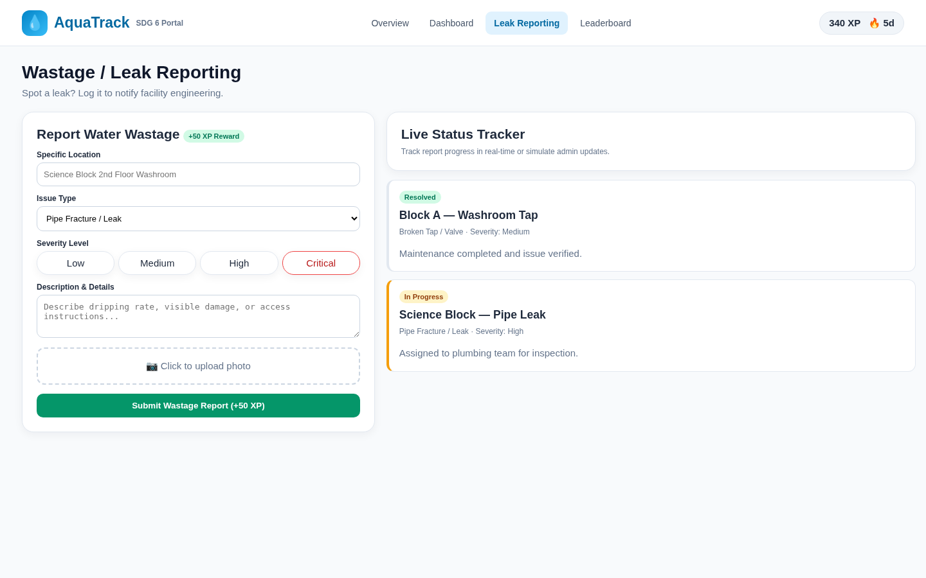
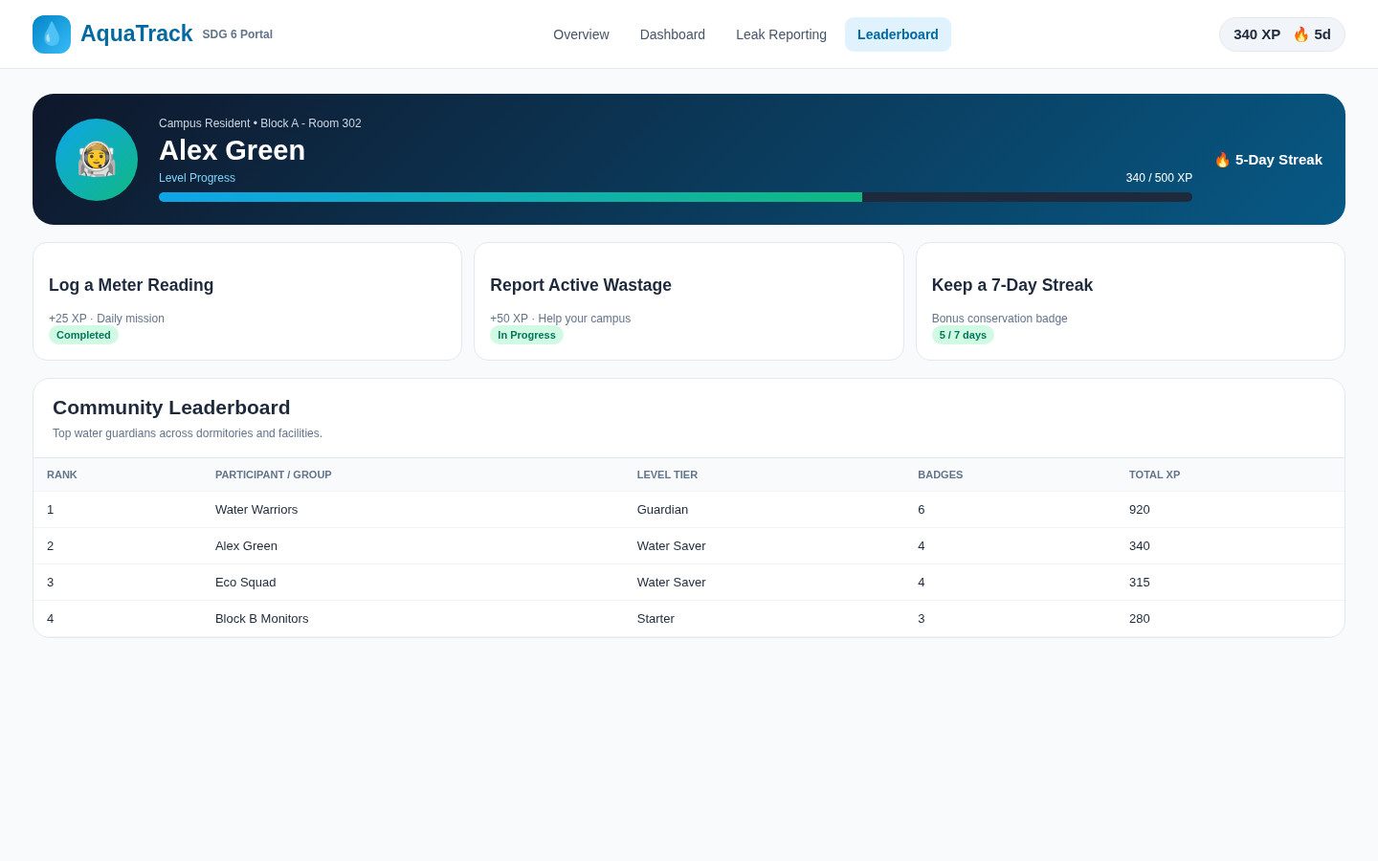
7. Website Screenshots — Reporting & Gamification
Interactive sections used during the live demonstration
Wastage Reporting
Gamification
Issue details, severity and corrective-action status.
XP, streaks, missions and leaderboard.
WATER CONSERVATION PORTAL • TEAM 6 11/12

Slide 12
8. Conclusion & Submission Checklist
The complete presentation and demonstration flow
Conclusion
Required Deliverables
AquaTrack provides a unified web-based approach to
water conservation by combining monitoring, reporting
and gamification.
The six individual ideas show different engineering /
IT approaches, while the final portal provides a practical
platform for demonstrating core conservation functions.
1. Website source code — AquaTrack HTML files
2. Hosted Website URL / Local Host — run the website
locally in a browser
3. PowerPoint Presentation — this 12-slide presentation
4. Live Demonstration — 5–7 minutes
5. Individual reports — submit softcopies with the PPT
as instructed
READY FOR LIVE DEMONSTRATION
WATER CONSERVATION PORTAL • TEAM 6 12/12

